Slide 1

Part 1: Usage Based Motor Insurance(UBMI) – Market Potential in INDIA Part 2: Analysis of driving behaviour using Telematics Data for Usage-Based Insurance
Project Name
Presented By: Sumanta Majumder

Slide 2
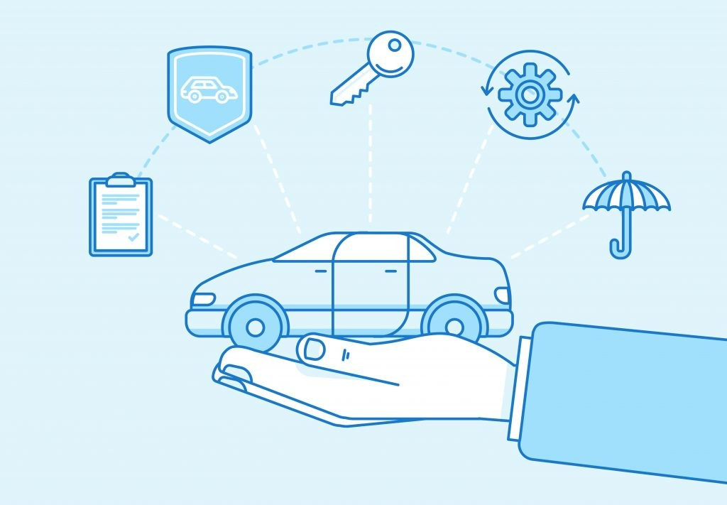
What is Usage Based Insurance (UBI)?
Type of insurance where the payable premium for the policy is directly linked with the usage of the insured product / service.
In the auto insurance industry, it is also commonly known as Telematics insurance.
Telematics is useful to track, store and transfer driving related data to the insurer and this data comes in handy to understand the driving behaviour and charge appropriate vehicle insurance rates.

Slide 3
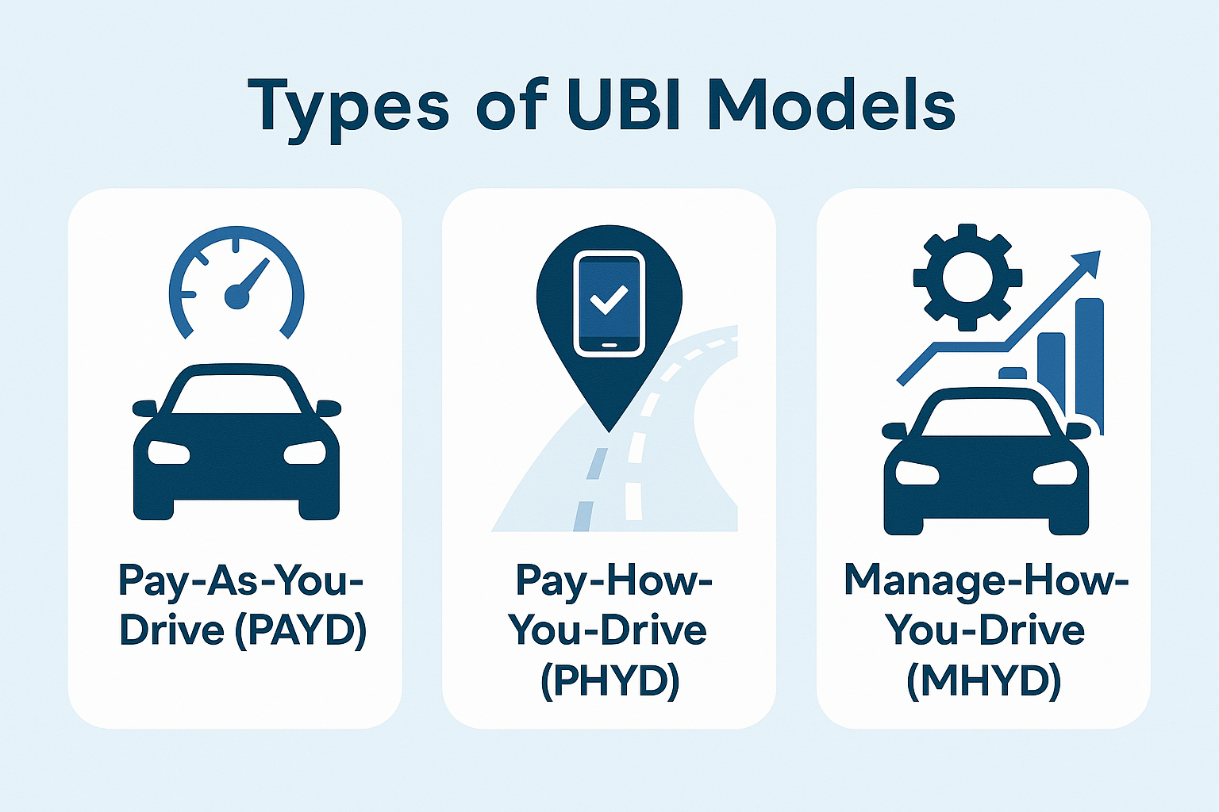
Pay-As-You-Drive (PAYD) – Premiums are based on the total distance driven.
Pay-How-You-Drive (PHYD) – Premiums depend on driving habits such as speed, braking, acceleration, and time of travel.
Manage-How-You-Drive (MHYD) – A more advanced model that provides real-time feedback and incentives for safe driving.

Slide 4

Technologies under UBI :
Based on technology, UBI is segmented under the following types:
a. Smartphones
b. Embedded Systems
c. Black Box
d. Other Technologies
In terms of revenue, the embedded system dominated the UBI global market with a revenue share of 50.16% in 2019.
The smartphone segment is projected to witness substantial growth over the next few years with recent CAGR observed at around 27%.

Slide 5
UBI – Global Insights :
North America dominated the market as of 2020 with a valuation of ~12 billion USD.
Asia Pacific is anticipated to exhibit a higher CAGR over the next few years led by increased mobile connectivity and smartphone technology.
Europe has been growing significantly due to increased regulatory support in relation to vehicle telematics.
In 2017, Italy implemented a law that requires insurance carriers to install telematics devices in all automobiles and set premiums based on real time data obtained.
The global insurance market is dominated by PAYD followed by PHYD and MHYD. MHYD is expected to be the fastest growing market aided by the evolution of data analytics technology.

Slide 6
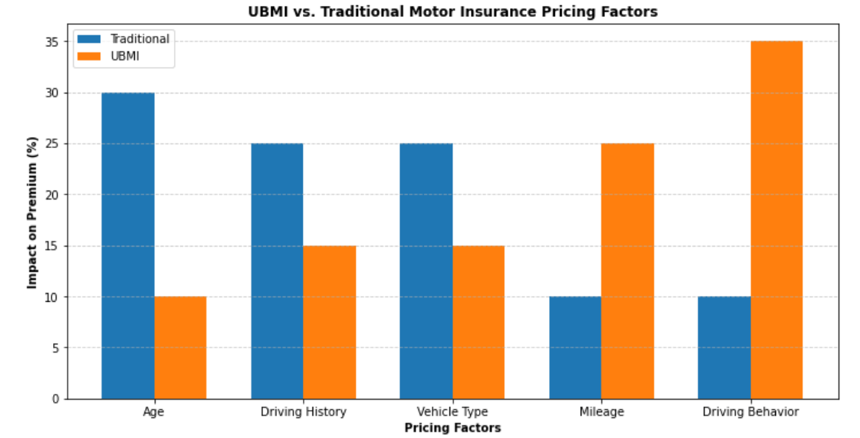
UBMI pricing and how it differs from traditional motor insurance pricing
Notes:
Usage and driving skills:
For traditional = Premiums are calculated irrespective of how much and how the car is driven. Premium based on past experience of claims in portfolio.
For ubi = Premium based on distance travelled and driving skills. A driver who drives long distance at high speed will be charged a higher rate than a driver who drives short distances at slower speeds.
Other factors:
For traditional = Type of cover, deductible opted, age of vehicle, use of vehicle, make and model of vehicle, where is vehicle parked over night, age and gender and occupation of policy holder etc.
For UBMI = distance driven, sriving skills, speed at which vehicle is driven, density of traffic, route on which vehicle driven, time of the day when driven etc.
From the graph:
Bar graph = Data is % impact on premium. Traditional insurance relies on static factors like Age and Vehicle type. These dominate pricing, which may disadvantage younger driver or those with high value cars even if they drive safely.
UBMI priorities behaviour(35%) and mileage(25%). It rewards safe drivers and low mileage users. From line graph: Traditional insurance is predictable but inflexible. A) fixed premium provide stability but offers no rewards for safe driving. Ex-A safe driver pays same as the reckless driver with the same age/vehicle. UBMI is volatile but rewarding. It means Premiums fluctuate based on driving patterns(e.g. safe months=discounts, risky months=penalties). Ex- A driver could save ₹1,500/year by avoiding late-night trips or harsh braking.

Slide 7
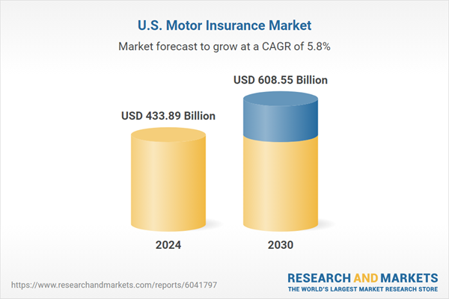
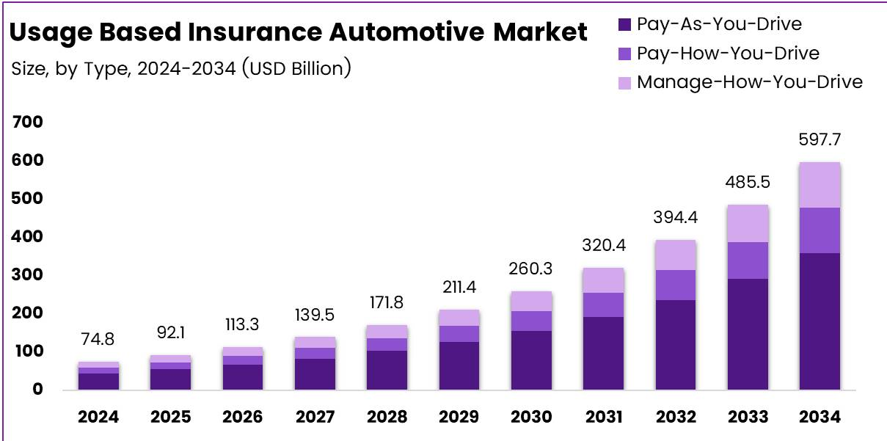
Comparison of the India market with the US market
Factor | India | U.S.
Adoption Stage | Early adoption (5-10% of motor market) | Maturity (30-40% of auto policies)
Key Players | Bajaj Allianz, ACKO | Progressive, Allstate, State Farm
Regulatory Support | IRDAI guidelines (2020) | State-level regulations since 2010s
Technology Drivers | Smartphone apps, FASTag data | Advanced telematics (e.g., Snapshot)
Consumer Trust | Growing but cautious | High (established incentives/discounts)
Notes:
Leading UBI programs in India: Bajaj alliance general insurance, Edelweiss General insurance, ACKO, ICICI Lombard, HDFC ERGO.
CAGR = Compound Annual Growth Rate. Formula: CAGR = (Ending Value / Beginning Value)^(1 / Number of Years) –1
Comparison Focus:
Side-by-side bars highlight India's faster UBI growth (30% in 2023) vs. the U.S.'s steadier growth (18% in 2023).
Visual Clarity:
Flag-inspired colors (India: saffron, U.S.: navy) improve readability and national relevance.
Data labels (e.g., 15%, 18%) make values explicit without cluttering the chart.
Trend Emphasis:
India’s bars grow taller yearly, showing accelerating adoption (15% → 30%), while the U.S. has slower but stable growth (12% → 18%).
Technical Best Practices:
np.arange ensures precise bar positioning.
ylim(0, 35) creates consistent whitespace for labels.
This code effectively visualizes divergent market dynamics between an emerging (India) and mature (U.S.) UBI market.

Slide 8
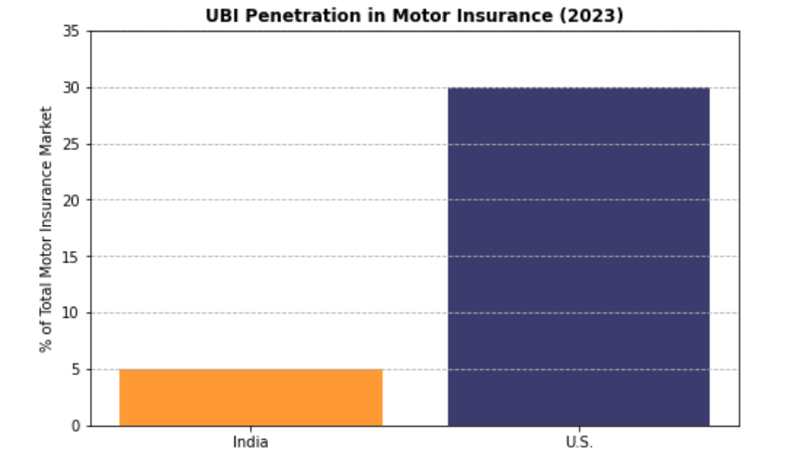
UBI penetration in India vs US
Notes:
Privacy Concerns (India: 35% vs. U.S.: 10%):
Indians distrust data-sharing practices, while U.S. consumers are more comfortable with telematics.
Infrastructure Gaps (India: 30% vs. U.S.: 5%):
Poor connectivity in rural India limits telematics reliability, unlike the U.S.’s robust infrastructure.
Regulatory Challenges (India: 20% vs. U.S.: 5%):
India’s UBI guidelines (IRDAI, 2020) are newer and less tested than the U.S.’s decade-old frameworks.
Low Awareness (India: 10% vs. U.S.: 15%):
Even in the U.S., awareness is low, but India’s nascent market lacks mass marketing campaigns.
High Device Costs (India: 5% vs. U.S.: 2%):
Affordability of OBD-II devices matters more in price-sensitive India.
Why This Justifies Slower UBI Adoption in India?
Cumulative Impact: India faces 90% total barriers (sum of 35+30+20+10+5) vs. the U.S.’s 37%, making UBI adoption 2–3x harder.
Dominance of Trust/Infrastructure Issues: Privacy and infrastructure alone account for 65% of India’s barriers vs. 15% in the U.S.
Supporting Visual Analogy?
Imagine UBI adoption as a car race:
India’s Car: Weighted down by heavy barriers (privacy, infrastructure).
U.S.’s Car: Lighter barriers (smooth regulatory roads, fewer potholes).

Slide 9

Key conclusion
Here are some conclusion over Usage Based Motor Insurance:
Market Growth and potential
Crucial Barriers in India.
UBI vs Traditional Pricing.
US success factors.
Future outlook for INDIA.
Strategic Recommendations.
Final Takeaway:
UBI is a game changer for India’s Insurance market, offering fairness and personalization. However, its mainstream success control on overcoming infrastructural, cultural and regulatory gaps. While the U.S comes with specific strategies, India needs tailored solutions to unlock UBI’s full potential.
Notes:
Market Growth & Potential:
India: Rapid growth (CAGR ~15–30%, 2019–2023) but low penetration (<10% of motor insurance). Early-stage adoption driven by tech-savvy urban users and fleets.
U.S.: Mature market with steady growth (~12–18% CAGR), ~30% penetration, supported by advanced telematics and consumer trust.
2. Critical Barriers in India:
Cultural/Behavioral: Privacy concerns, distrust in data sharing, and preference for traditional fixed-premium models.
Infrastructure: Poor rural connectivity and high costs of telematics devices (OBD-II, dongles).
Regulatory: Nascent guidelines (IRDAI, 2020) vs. the U.S.’s decade-old frameworks.
Economic: Price sensitivity and low motor insurance penetration (~35% of vehicles insured).
3. UBI vs. Traditional Pricing:
UBMI (Usage-Based): Dynamic pricing based on driving behavior, mileage, and real-time data. Rewards safe drivers (e.g., discounts up to 30%).
Traditional: Static pricing based on age, vehicle type, and historical claims. Inflexible and opaque.
4. U.S. Success Factors:
Robust infrastructure, consumer trust in data-driven services, and insurer incentives (e.g., Progressive’s 20–30% discounts).
Regulatory clarity and standardized telematics adoption.
5. Future Outlook for India:
Growth Drivers: EV adoption (built-in telematics), FASTag data integration, and partnerships (insurtechs + OEMs).
Projection: UBI could reach 15–20% penetration by 2030 if barriers like privacy, infrastructure, and awareness are addressed.
6. Strategic Recommendations:
Insurers: Subsidize telematics costs, gamify safe driving rewards, and target urban millennials/EV owners.
Government: Strengthen data privacy laws and incentivize telematics adoption (e.g., tax breaks).
Consumers: Leverage UBI for long-term savings if driving habits are safe.

Slide 10

Analysis of driving behaviour using Telematics Data for Usage-Based Insurance
Introduction of Telematics Data : For automobile insurers, telematics represents a growing and valuable way to quantify driver risk. Instead of pricing decisions on vehicle and driver characteristics, telematics gives the opportunity to measure the quantity and quality of a driver's behaviour.
Some analysis of driving behaviour using Telematics data for Usage-Based Insurance.
Here are our features of our data:
deviceId : Unique identifier for the vehicle or driver generating the data.
timeMili : Millisecond-level timestamp indicating the event’s precise occurrence.
timestamp : Human-readable date and time when the event was recorded.
value : Measured sensor reading (e.g., speed, acceleration, RPM, etc.)
variable : Name of the specific sensor or data stream being captured.
alarmClass: Severity level of the alert generated during the event (typically integer-coded).

Slide 11
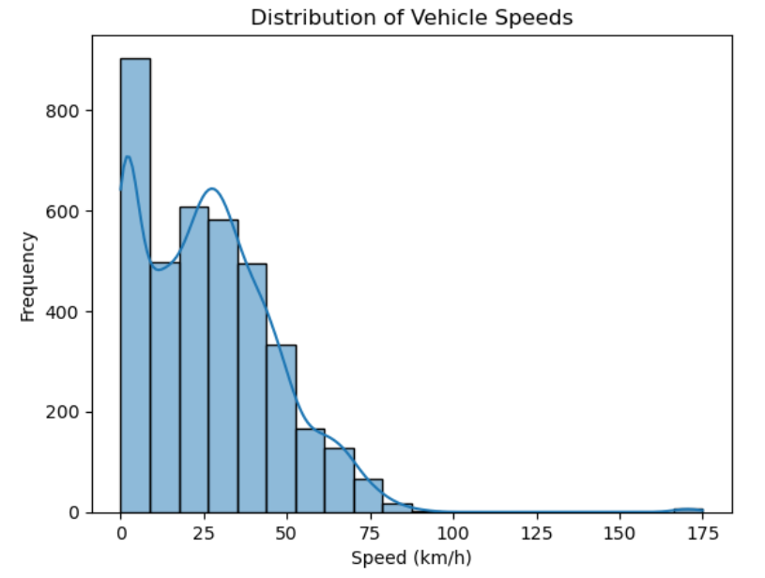
Visualization of Speed Distribution
This will reveal general speed trends.
Notes:
This visualization is a histogram of vehicle speed distribution in kilometers per hour (km/h), enriched with a smoothed kernel density estimate (KDE) curve overlay.
X-axis: Vehicle speeds from 0 to around 175 km/h
Y-axis: Frequency (number of instances observed at that speed range)
There is a sharp peak near 0 km/h, suggesting either a lot of idling/stopping events or low speed urban driving.
A second, smaller bulge occurs around 20–25 km/h, likely capturing slower urban or start-stop traffic.
Beyond 40 km/h, frequencies drop off steadily — indicating high-speed driving was much less common. There’s a long right tail, indicating occasional high-speed movement, though these events are relatively rare.
Very few instances exceed 100 km/h, reinforcing that high-speed driving is uncommon in this dataset.

Slide 12
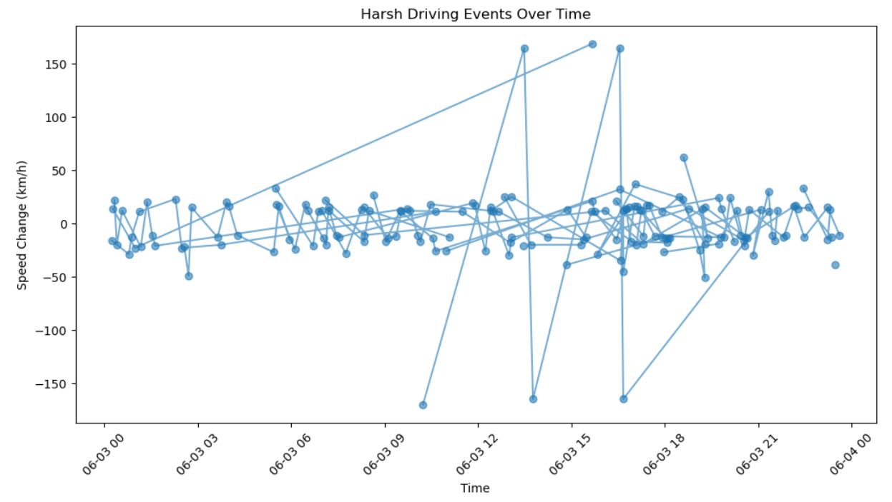
Visualizing Harsh Events Over Time
This will show trends in harsh driving
Notes:
This plot shows fluctuations in vehicle speed over time, highlighting sharp spikes and drops that represent harsh driving behaviors such as sudden acceleration or braking. The y-axis reflects speed change in km/h, while the x-axis captures the timeline from June 3 to June 4. Frequent swings around ±100 km/h suggest aggressive maneuvers that may impact driver safety and vehicle health.
A negative speed change simply means the vehicle slowed down, and the value represents the drop in speed between two timestamps. For example, if a vehicle decelerates from 60 km/h to 40 km/h, the speed change is −20 km/h.

Slide 13
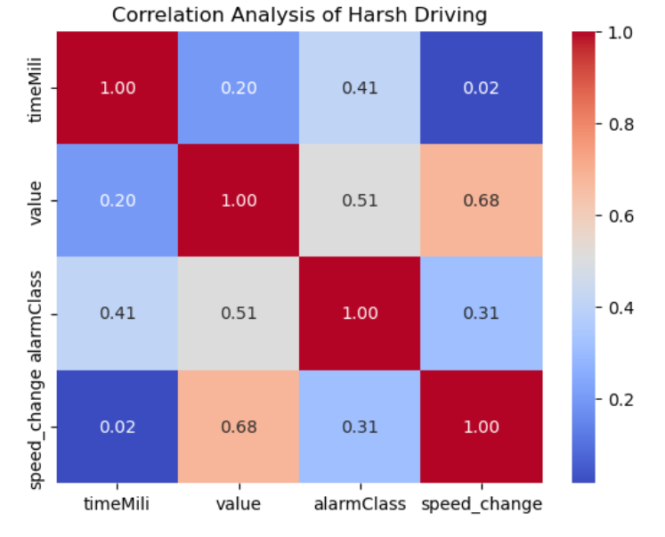
Correlation Analysis of Harsh driving
Notes:
value and speed_change have a strong positive correlation (0.68), meaning as sensor values increase (likely speed or acceleration), speed changes also tend to rise.
value and alarmClass are moderately correlated (0.51) → higher values are often tied to more severe driving alerts.
alarmClass and timeMili show a mild upward trend (0.41) → risk events appear to increase gradually over time.
speed_change and alarmClass have a positive correlation (0.31) → sudden changes in speed are linked to higher alarm classes.

Slide 14
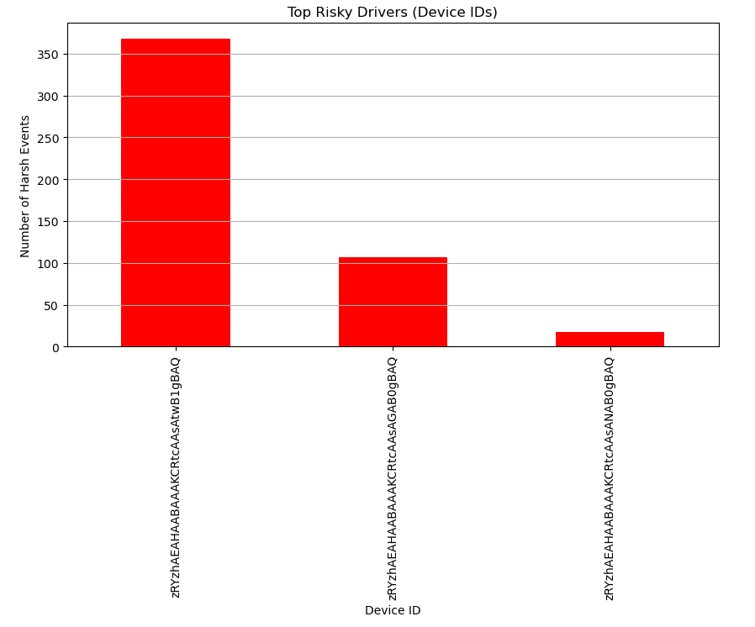
Identifying Risky Drivers
If certain drivers consistently have the most incidents, this insight can help recommend training or intervention.
Notes:
This bar chart highlights the top risky drivers based on the number of harsh driving events recorded per device ID. The driver represented by the first device ID has the highest count (~350 events), significantly more than the next two (~150 and ~50 events), indicating a clear outlier in risky behaviour. It’s an effective summary for identifying priority cases for intervention or further analysis.

Slide 15
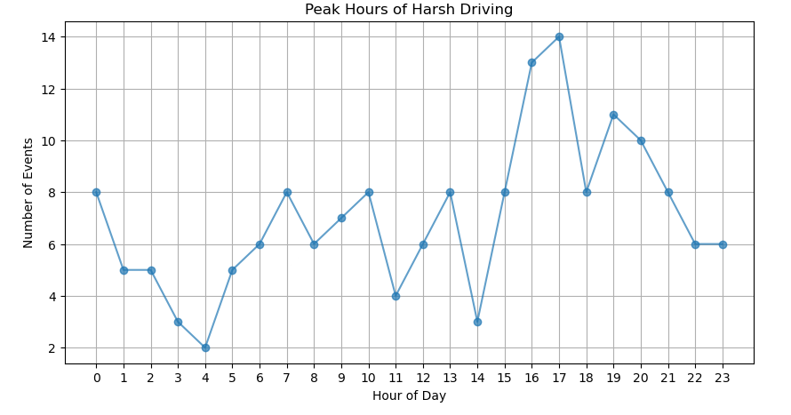
Peak Hours of Harsh Driving
Notes:
This line plot shows the hourly distribution of harsh driving events throughout the day. Peaks at hours like 0, 7, 8, 16, and 18 suggest that risky driving behaviour most often occurs during late-night hours and typical commute times—likely due to fatigue, traffic congestion, or rushed driving.

Slide 16
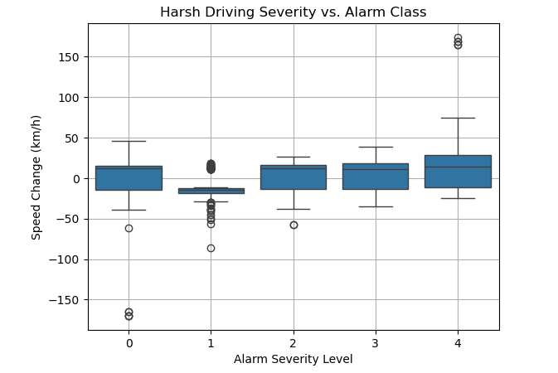
Harsh Driving Severity vs Alarm Class
This will show whether severe alarms are triggered more often by extreme speed changes.
Notes:
This box plot visualizes how speed change (km/h) varies across different alarm severity levels (0 to 4). Each box summarizes the spread of speed changes for its corresponding alarm class:
Alarm Level 0 has the widest spread and the most extreme outliers—suggesting a wide range of speed changes even without alarms, possibly due to normal or misclassified behavior.
Lower severity levels (e.g., 1) have tighter boxes and more outliers, indicating consistent but occasionally extreme behavior.
Higher severity levels (e.g., 4) show wider boxes, meaning more variability in speed changes—potentially reflecting harsher or less predictable driving.

Slide 17
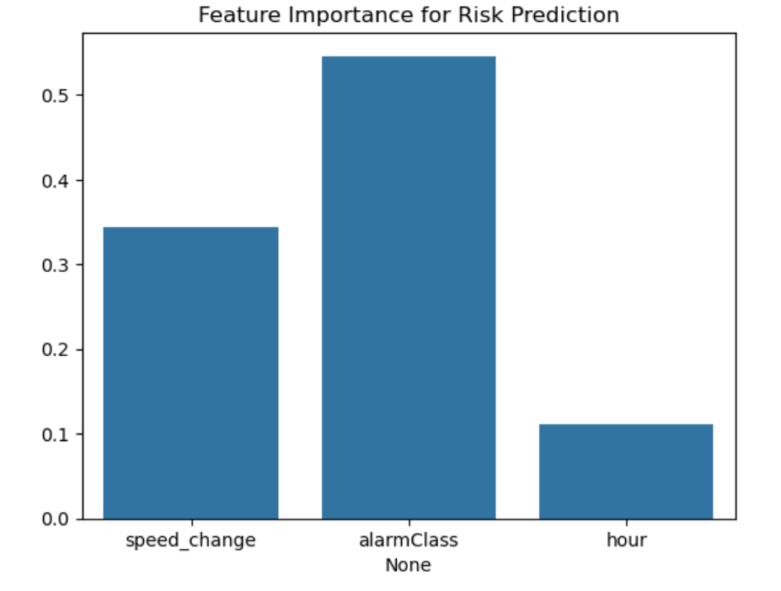
Feature importance & Optimization
This helps determine which driving behaviours contribute most to risk.
Notes:
Alarm patterns and speed changes are the strongest indicators of risky driving.
Alarm data (or its absence) is the top predictor of risk.
Speed variability reflects aggressive driving behavior.
Time-based patterns contribute less, suggesting behavior matters more than schedule.

Slide 18
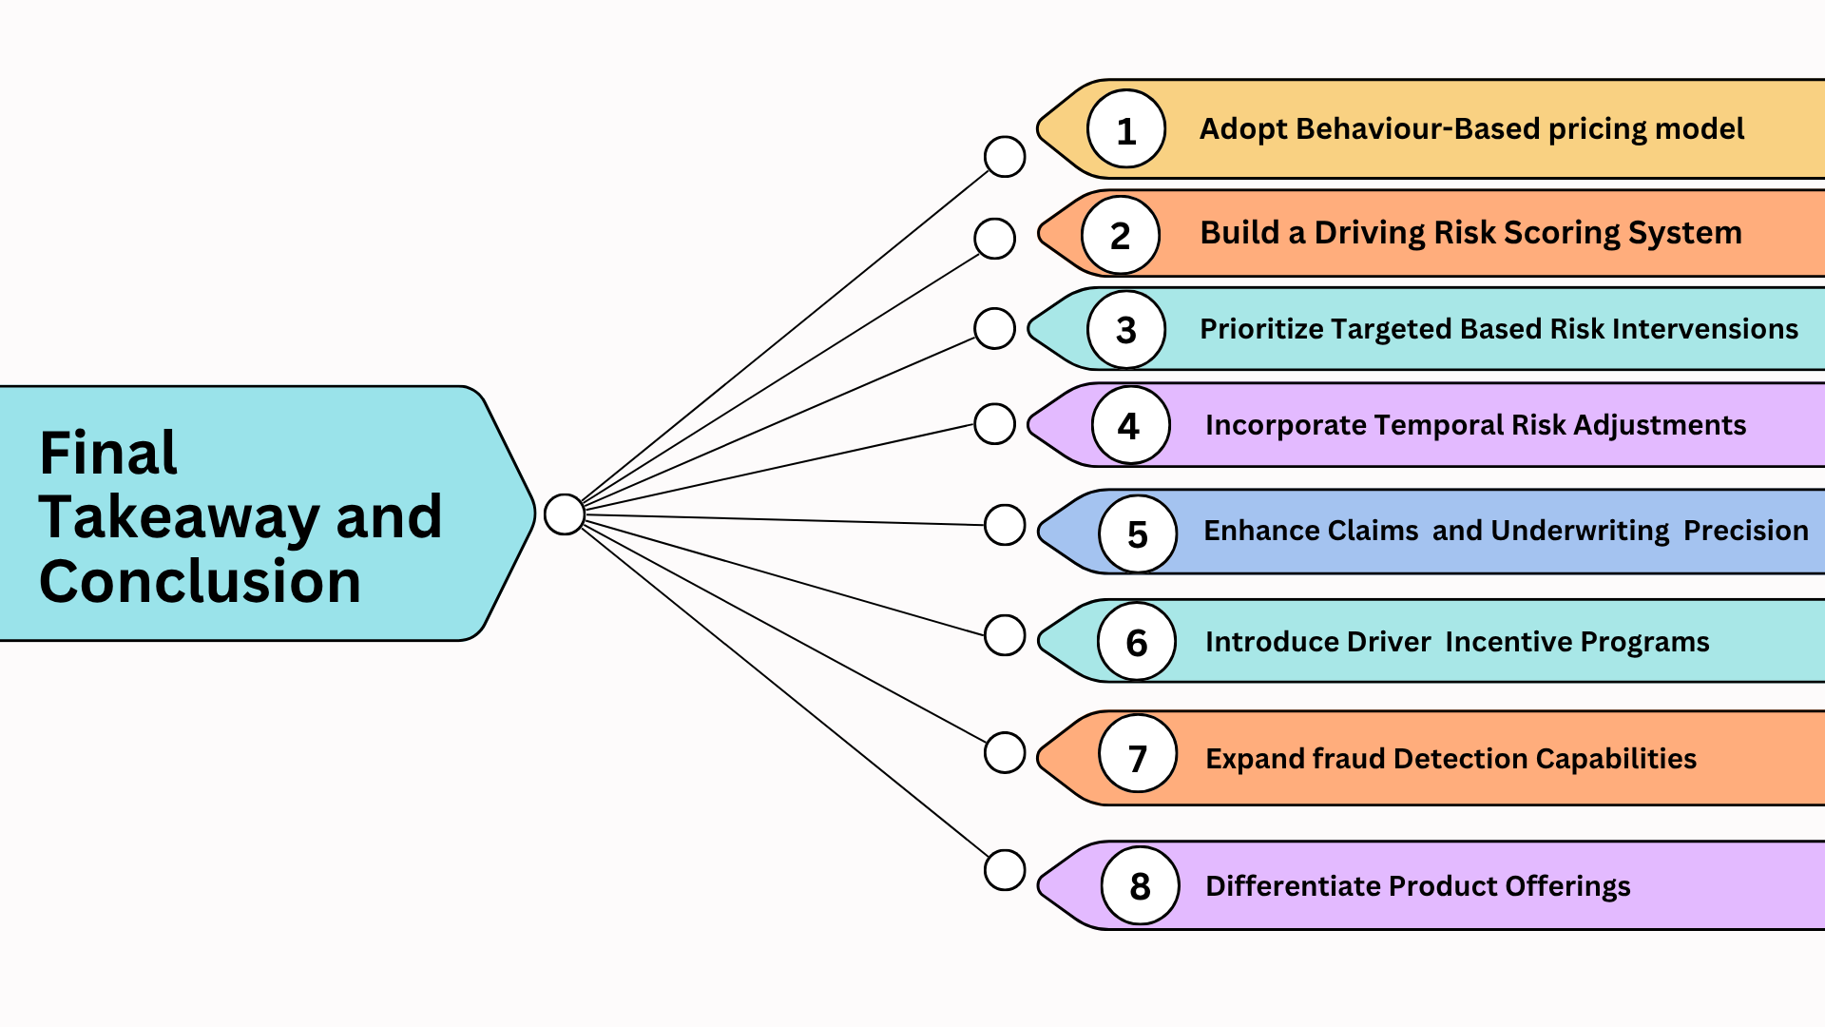
Notes:
Adopt Behavior-Based Pricing Models: Use speed change, alarm frequency, and driving patterns to create dynamic premium structures based on individual risk profiles.
Build a Driver Risk Scoring System: Leverage key predictive features (like alarmClass, speed_change) to develop a real-time driver safety score, enabling fairer pricing and better risk assessment.
Prioritize Targeted Risk Interventions: Focus on high-risk drivers identified through clustering and event frequency for coaching, policy adjustment, or telematics-based nudges.
Incorporate Temporal Risk Adjustments: Hourly distribution insights allow you to develop time-sensitive risk modifiers—e.g., charge higher premiums or trigger alerts during peak risk periods like late nights or rush hours.
Enhance Claims & Underwriting Precision: Use behavioral correlations (like speed spikes tied to high alarm severity) to support claim validation, detect anomalies, and optimize underwriting.
Introduce Driver Incentive Programs: Reward consistently safe drivers with discounts or incentives, encouraging long-term engagement and reducing churn.
Expand Fraud Detection Capabilities: Monitor inconsistencies in telemetry—like zero alarms despite aggressive driving patterns—to flag potential data tampering.
Differentiate Product Offerings: Offer tiered products: e.g., “Safety-first plan” with live feedback, or “Mileage-based plan” combined with behavior metrics.

Slide 19


